Slide 1
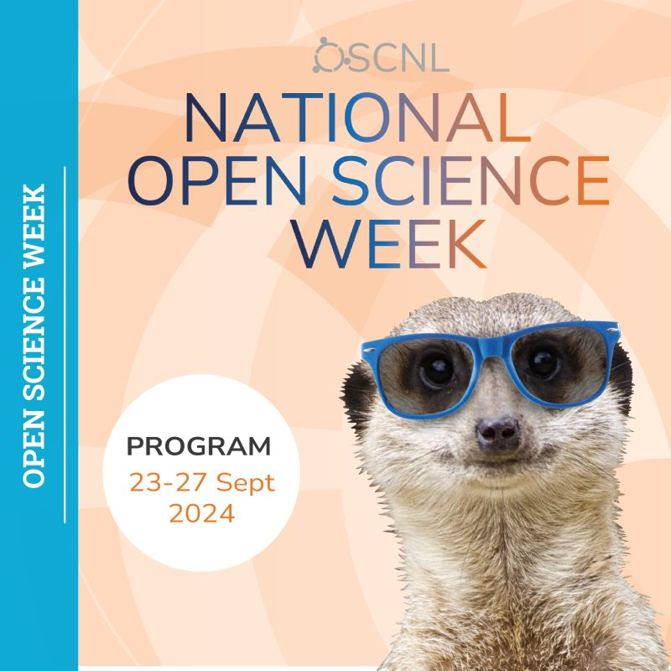
Open Science – a gentle introduction
Gerben ter Riet, MD PhD
Open Science Support Desk, Faculty Health, Sports & Exercise
Amsterdam University Applied Sciences
https://orcid.org/0000-0002-2231-7637

Slide 2
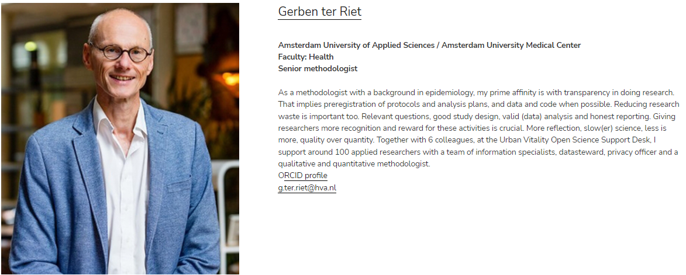
About your presenter
Notes:
https://osc-international.com/open-science-community-amsterdam/

Slide 3

On the menu today
O P E N S C I E N C E
What?
Why?
How?
Critique?
Notes:
https://www.unesco.org/en/open-science
https://osf.io/preprints/psyarxiv
https://info.arxiv.org/about/people/index.html
Better-more transparent-accessible-inclusive-collaborative
Sharing (paywalls)
Bridging gap science-society
Interacting with marginalized groups

Slide 4
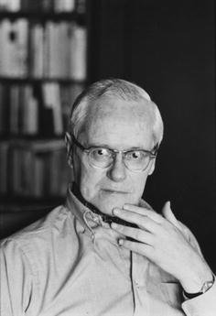
Idealized Science (Robert Merton)
CUDOS (The Sociology of Science, Merton, 1942)
C = Communality:
Science is a public good
U = Universalism:
Validity of claims independent of claimant’s status
D = Disinterestedness:
Do it for benefit of mankind
OS = Organized skepticism:
Assess claims with detached critical scrutiny
Notes:
temporary suspension of judgement, 'detached' critical scrutiny
OS: Science as a whole [Merton], Institutes, Depts, Teams, Individuals ~ falsification (corroboration) Popper
C: commercial interests, competing states and economies (“kennisveiligheid”), fear of being scooped
U: research from emerging economies or countries with limited oversight of science (and ethics) may be ignored
D: governments require scientists to collaborate with companies; stimulate start-ups (mixing of interests)
OS: scientists are expected to deliver. It may be hard to acknowledge that a promising intervention does not work. Scientists are expected to collaborate with other parties towards implementation, but what if the treatment does not work. Tunnel vision (due to over-enthusiasm or other factors) may lead to uncritical conclusions or worse.

Slide 5
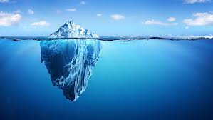
Why Open Science?
Social justice
Reusability
Quality
Access
Notes:
https://nl.wikipedia.org/wiki/Diederik_Stapel
https://retractionwatch.com/the-retraction-watch-leaderboard/
Social justice: wish to incorporate views and needs of marginalized groups internationally or within countries
Reusability: too much emphasis on the technical aspects. But are the data worth reusing? https://pubmed.ncbi.nlm.nih.gov/38514869/
Quality: time pressures and other factorss (methodologic ignorance) often lead scientists to cut corners
Acsess: very expensive subscription rates to scientific journals. Open access publication led to double dipping (paying for subscriptions and for open access)

Slide 6
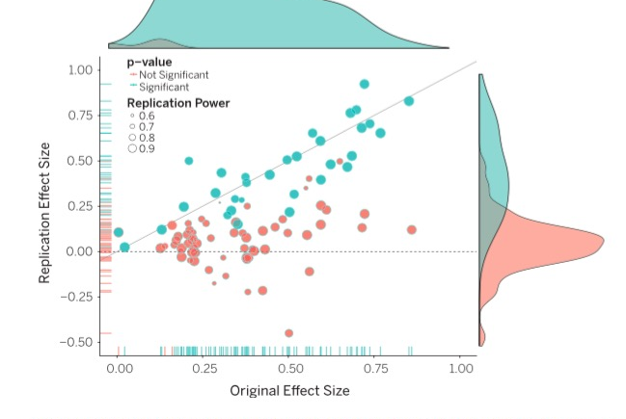
Replicating 100 psychology studies
Notes:
https://www.nsf.gov/discoveries/disc_videos.jsp?org=NSF&cntn_id=136139&media_id=79235

Slide 7
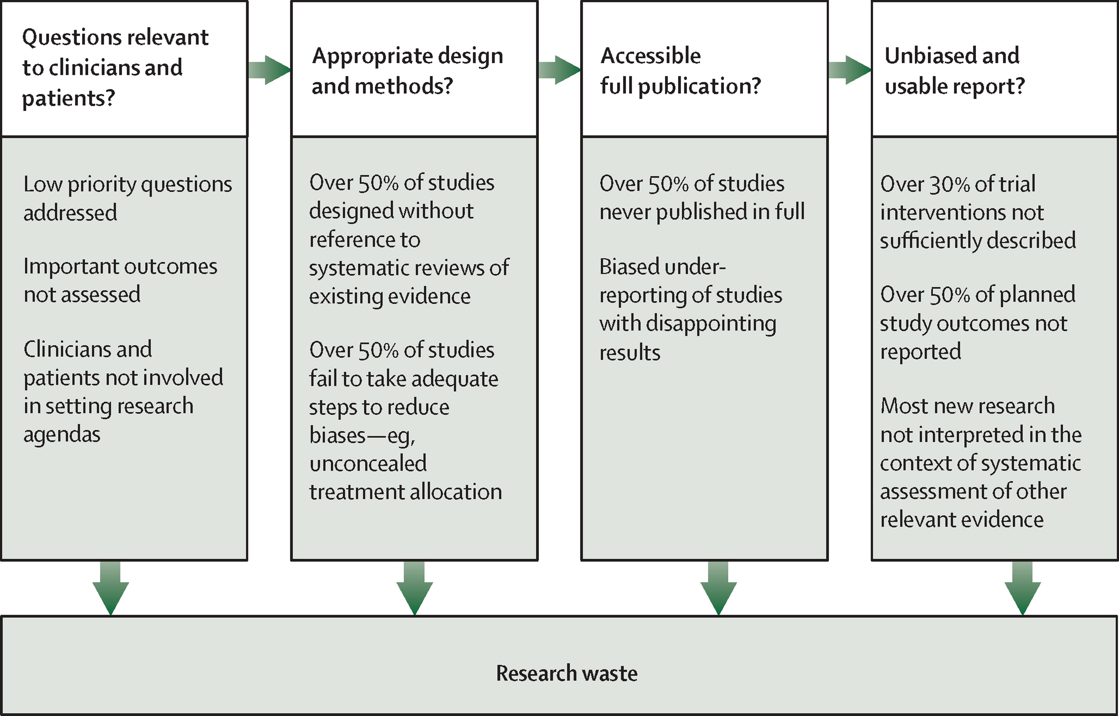
Why open science: reasons from medicine

Slide 8
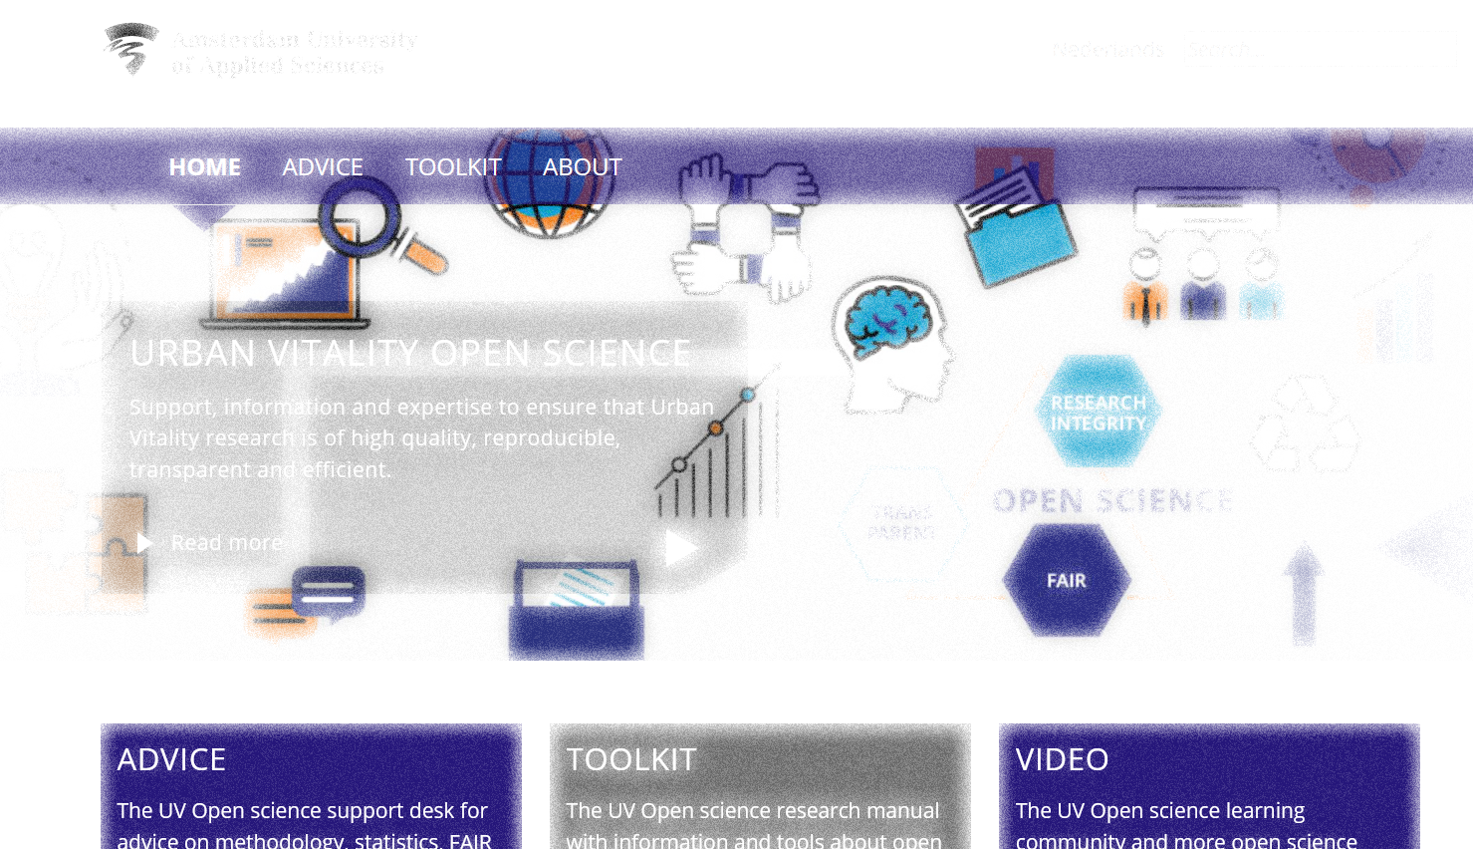
How to do Open Science?
Example of the open science checklist at my faculty
Notes:
https://www.amsterdamuas.com/uv-openscience

Slide 9
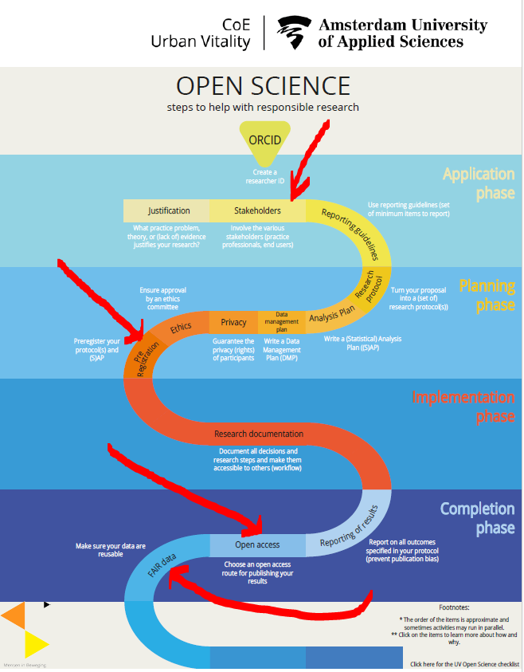
Notes:
https://doorwerking-hbo-onderzoek.nl/portfolio/open-science-checklist/ [in Dutch]
https://uvaauas.figshare.com/articles/online_resource/Open_science_checklist_Urban_Vitality/12213467
https://www.amsterdamuas.com/uv-openscience
https://hbo-kennisbank.nl/details/amsterdam_pure:oai:pure.hva.nl:publications%2F00c80703-c54b-4bf5-a3c5-bcc8f339995b?has-link=yes&q=support+desk

Slide 10

Urban Vitality Open Science Checklist
Ensure privacy for participants
Consider ethics advice
Preregister protocol and (S)AP
Document your research
Report completely
Publish open access
Archive using FAIR principles
Get an ORCID
Justify relevance
Involve end-users
Consider reporting guidelines
Write detailed protocol
Write detailed analysis plan
Write data management plan
Notes:
https://doorwerking-hbo-onderzoek.nl/portfolio/open-science-checklist/ [in Dutch]
https://uvaauas.figshare.com/articles/online_resource/Open_science_checklist_Urban_Vitality/12213467
https://www.amsterdamuas.com/uv-openscience
https://hbo-kennisbank.nl/details/amsterdam_pure:oai:pure.hva.nl:publications%2F00c80703-c54b-4bf5-a3c5-bcc8f339995b?has-link=yes&q=support+desk
https://www.go-fair.org/fair-principles/

Slide 11
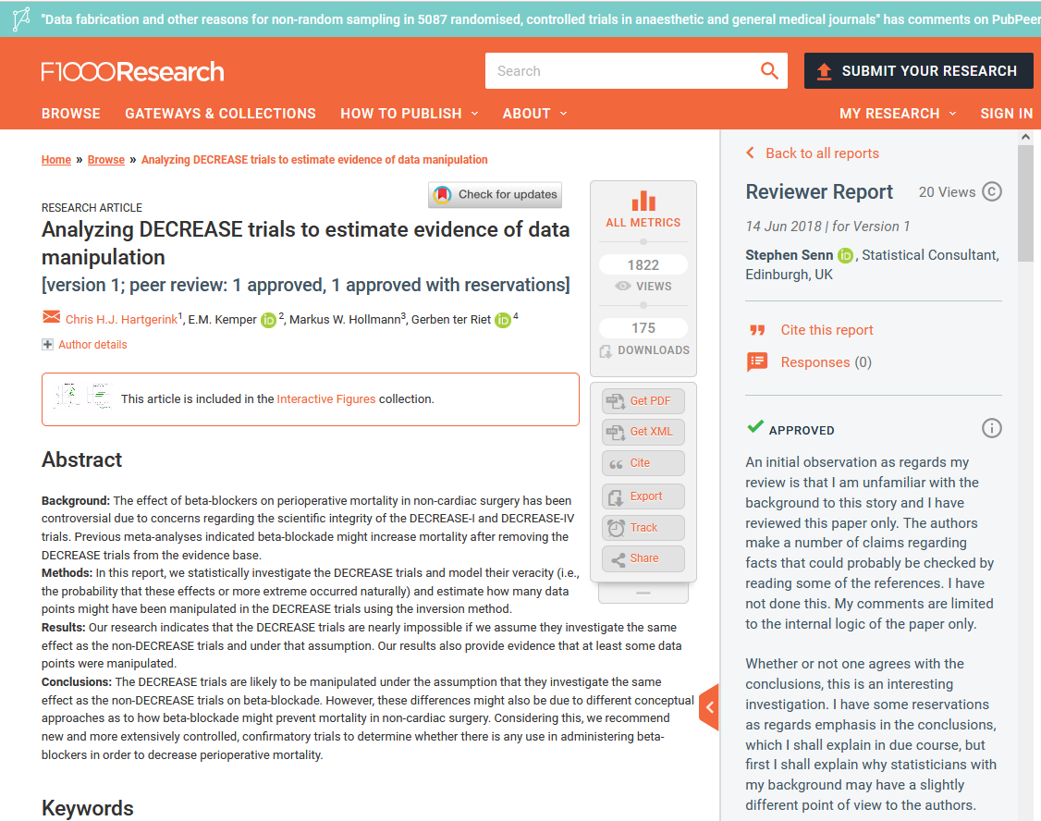
How – an example

Slide 12
SOURCES OF Inspiration FOR THe CHECKLIST
Dutch code scientific integrity 2018
Avoidable Research Waste (Lancet 2014)
Replication crisis (Nosek, www.osf.io)
Open Science literature (citizen science, FAIR)
Notes:
https://www.thelancet.com/campaigns/efficiency

Slide 13
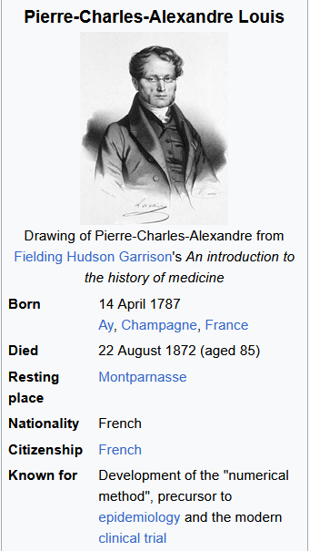

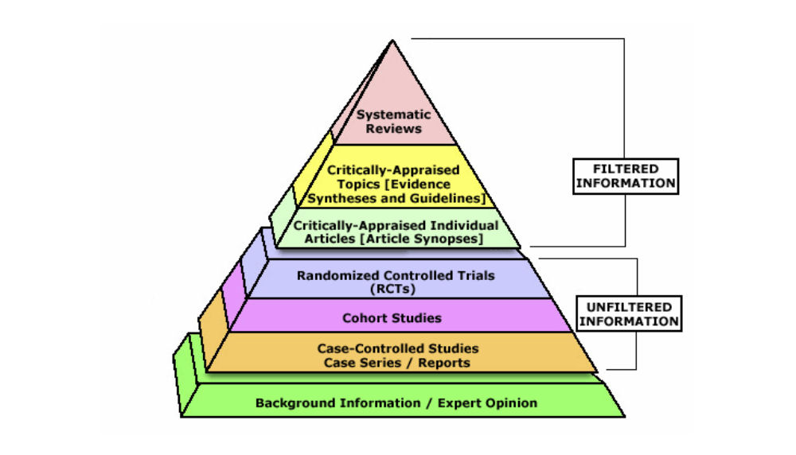
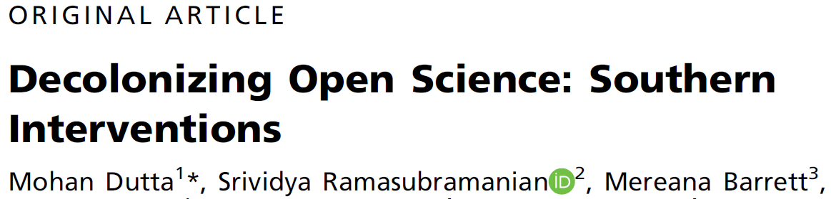
History of Medicine: action and reaction
1999
1890s
2010
“In physiology we must never make average descriptions of experiments because the true relations of phenomena disappear in the average; [.] we must [.] present our most perfect experiment as a type’’. 1865
1980s
2021
Notes:
Bernard C (1865) Introduction a` l’e´tude de la medicine experimentale.
https://en.wikipedia.org/wiki/Pierre_Charles_Alexandre_Louis
https://www.campbellcollaboration.org/
https://academic.oup.com/joc/article-abstract/71/5/803/6364108

Slide 14

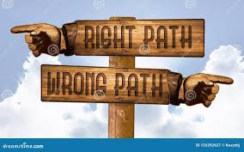

Getting the incentives right
Notes:
https://coara.eu/
https://sfdora.org/
https://integgame.eu/dilemma
https://www.eur.nl/en/about-eur/policy-and-regulations/integrity/research-integrity/dilemma-game

Slide 15


Slide 16
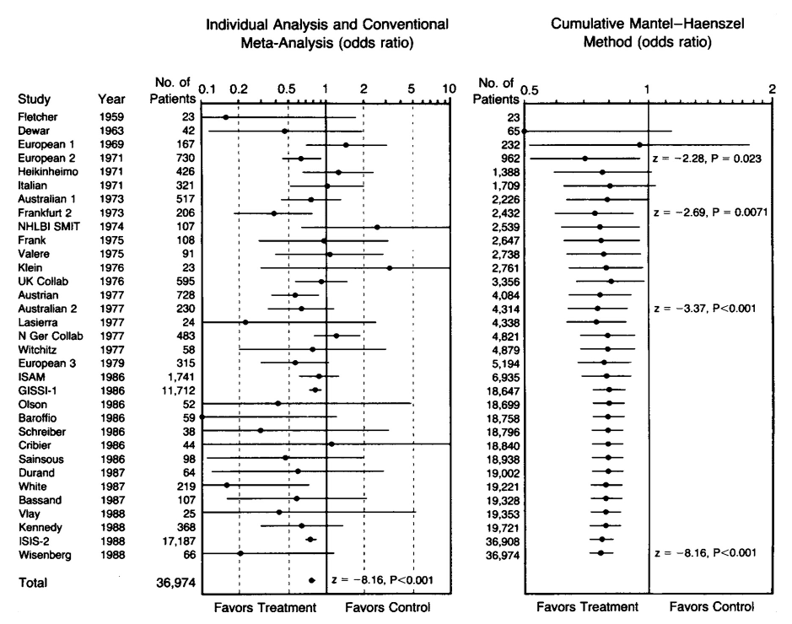
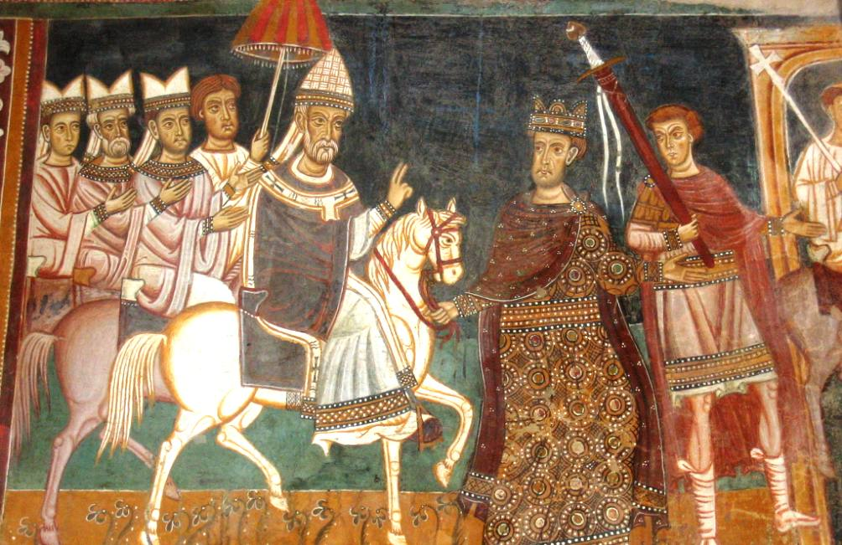
Research questions have a history: from Lorenzo Valla to Joseph Lau
Systematic text critique (1440)
Critical appraisal (1992-..)
Notes:
3 types of consistency (Valla)
chronological; 2. logical; 3. linguistic
1=date and content do not match
2= if event is described in doc A, then we expect it to be mentioned in doc B
3= some terms not used before a certain date (Byzantion vs Constantinople)
Iconoclastic approach building on huge and careful collection of literature over many years

Slide 17

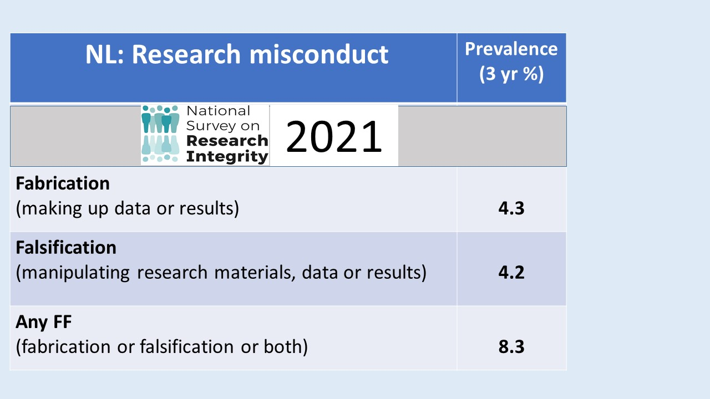
Science in the real world
Notes:
https://www.nrin.nl/projects/nsri
https://f1000research.com/articles/11-471
https://journals.plos.org/plosone/article?id=10.1371/journal.pone.0263023
https://osf.io/dp6zf/

Slide 18
Instructions for authors of 835 Journals
Notes:
https://journals.plos.org/plosone/article?id=10.1371/journal.pone.0222157

Slide 19
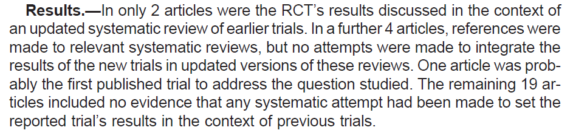
The totality of the evidence

Slide 20
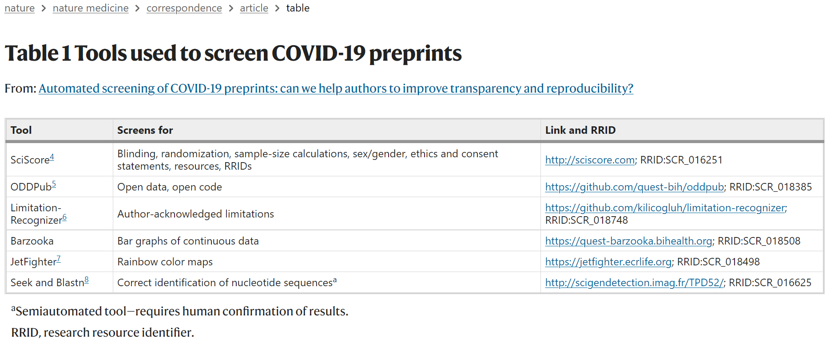
Multi-component AI tools
Nat Med 27, 6–7 (2021)
Notes:
Weissgerber, T., Riedel, N., Kilicoglu, H. et al. Automated screening of COVID-19 preprints: can we help authors to improve transparency and reproducibility?. Nat Med 27, 6–7 (2021). https://doi.org/10.1038/s41591-020-01203-7

